Slide 1
Introduction to NumPy
Unit 1

Slide 2
What is NumPy?
NumPy (Numerical Python) is an open-source Python library used for performing numerical and mathematical computations efficiently. It provides a powerful N-dimensional array object along with functions to perform operations such as mathematical calculations, statistical analysis, linear algebra, random number generation, and matrix operations.
NumPy was developed by Travis Oliphant in 2005 and is one of the most important libraries in Python for scientific computing.

Slide 3
Why Do We Need NumPy?
Python lists are useful for storing data, but they become slow and consume more memory when working with large numerical datasets.
NumPy solves these problems by providing:
Faster execution
Less memory usage
Efficient mathematical operations
Multi-dimensional arrays
Vectorized computations (operations without loops)

Slide 4
Applications of NumPy
NumPy is widely used in:
Data Science
Machine Learning
Artificial Intelligence
Scientific Research
Image Processing
Computer Vision
Financial Analysis
Statistics
Robotics
Engineering Simulations

Slide 5
Features of NumPy
Supports multi-dimensional arrays.
High-speed mathematical operations.
Efficient memory management.
Supports matrix computations.
Large collection of mathematical functions.
Random number generation.
Compatible with Pandas, Matplotlib, SciPy, TensorFlow, etc.

Slide 6
Advantages of NumPy
Python List | NumPy Array
Slow | Fast
More memory | Less memory
Difficult mathematical operations | Easy mathematical operations
Limited functionality | Rich scientific functions

Slide 7
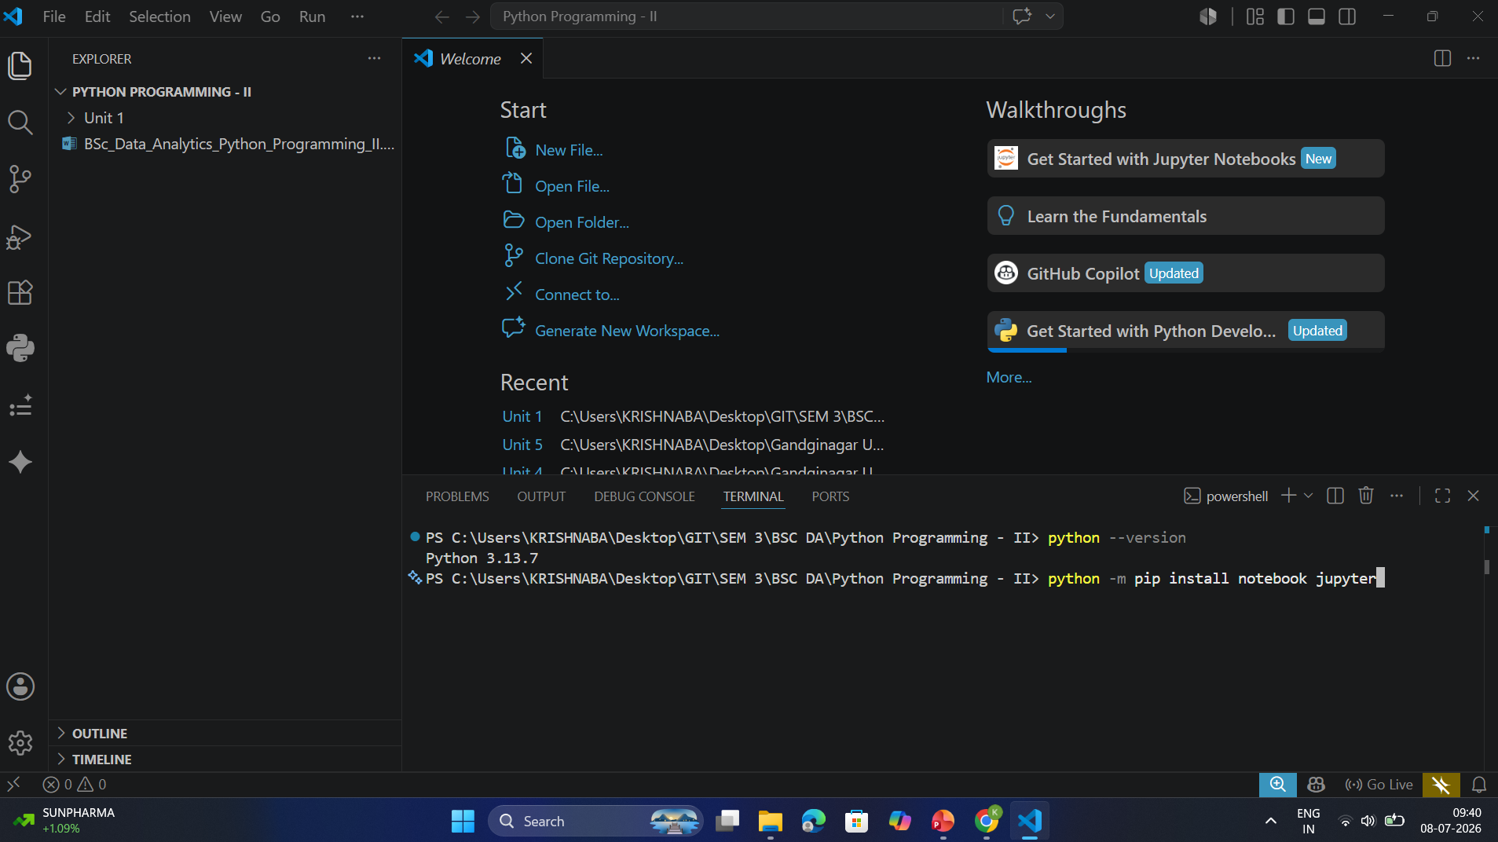
Installation

Slide 8
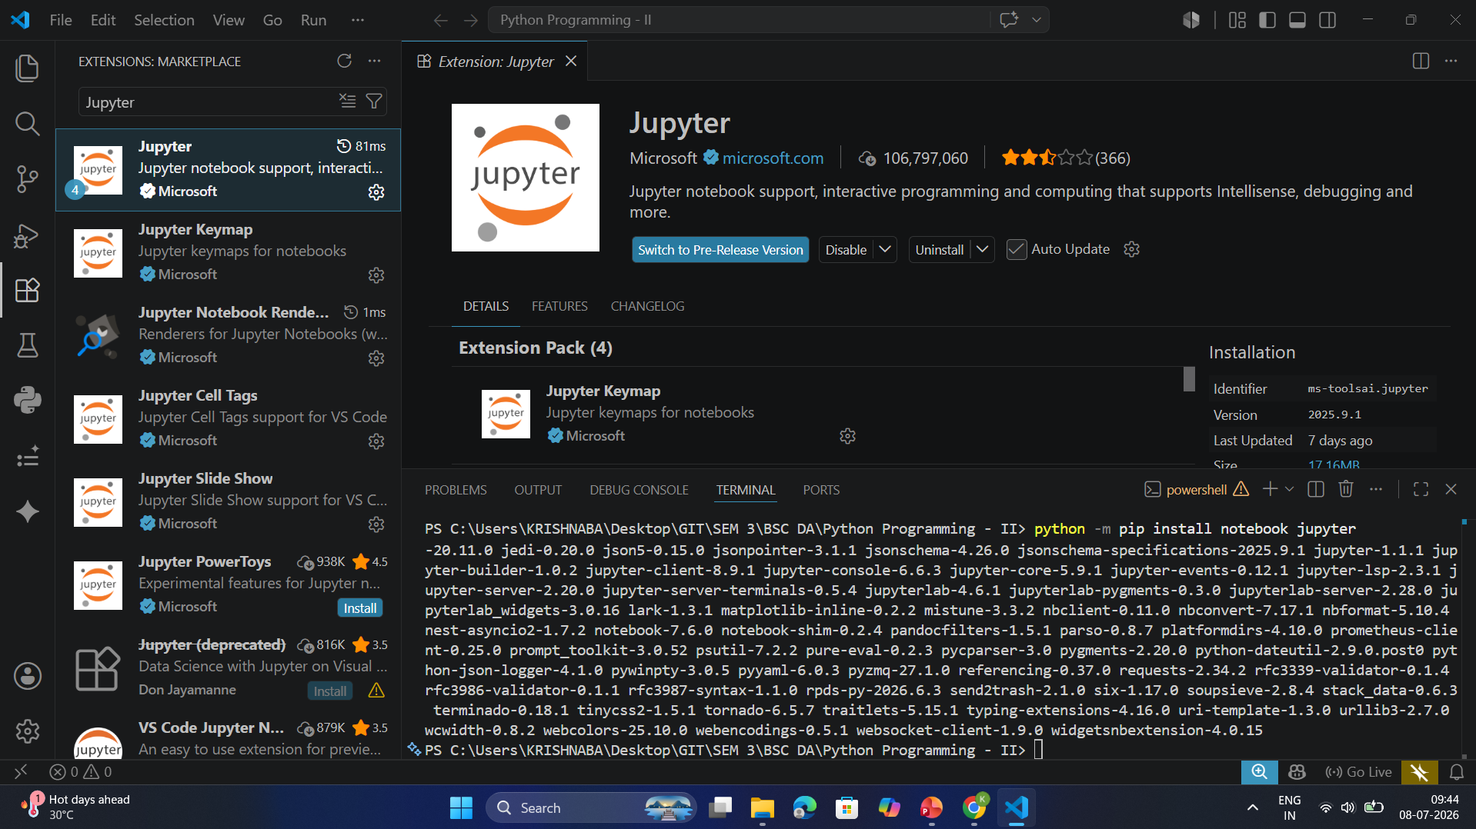
Installation

Slide 9
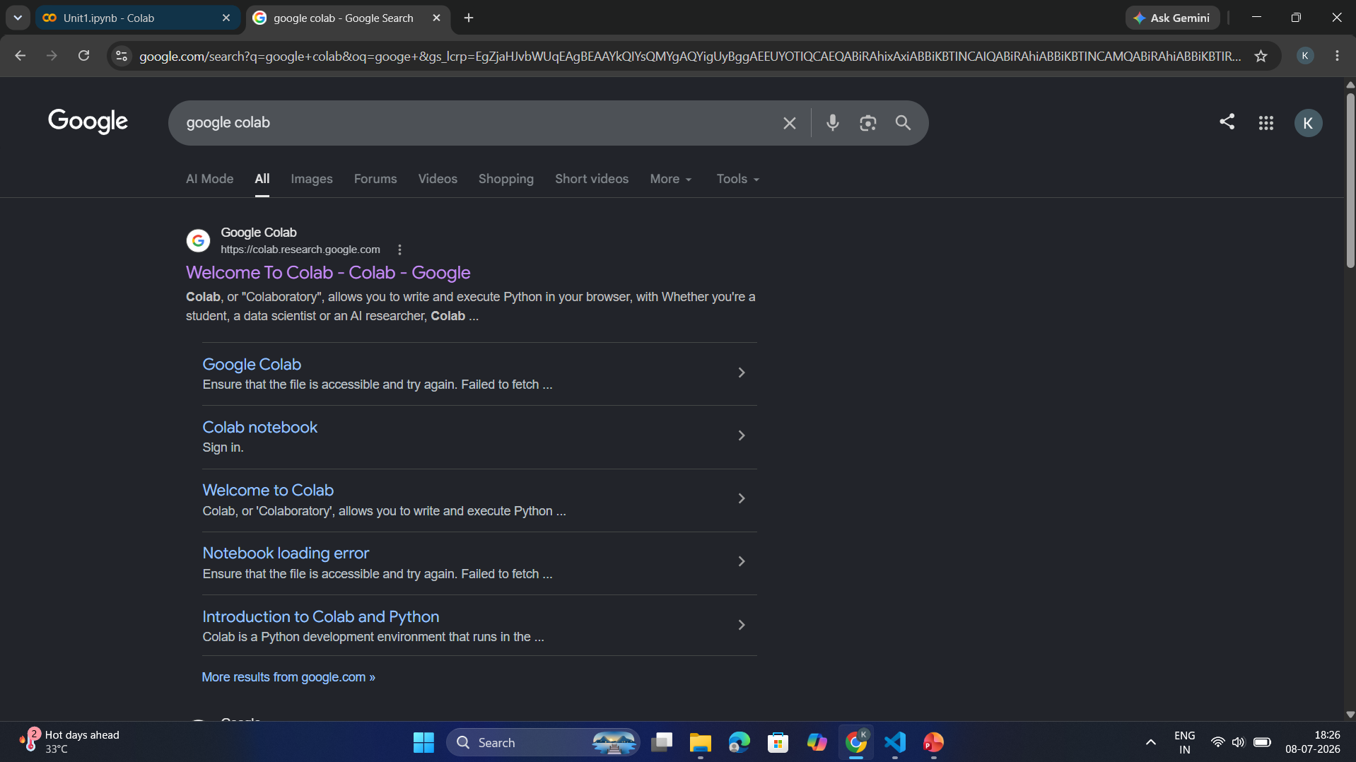
Installation

Slide 10
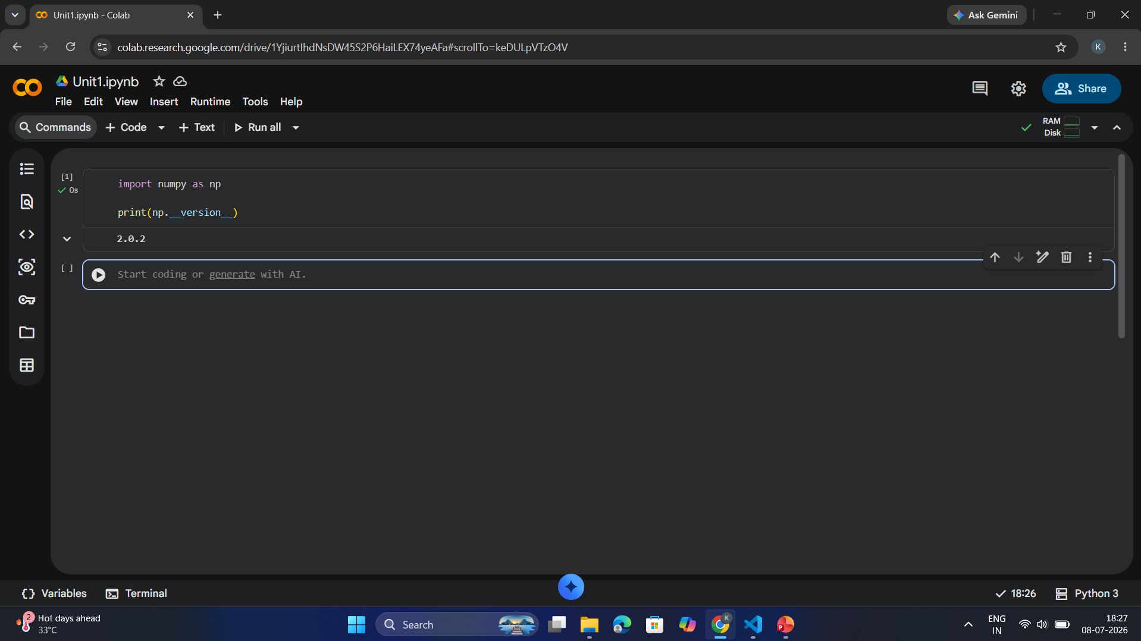
Installation

Slide 11
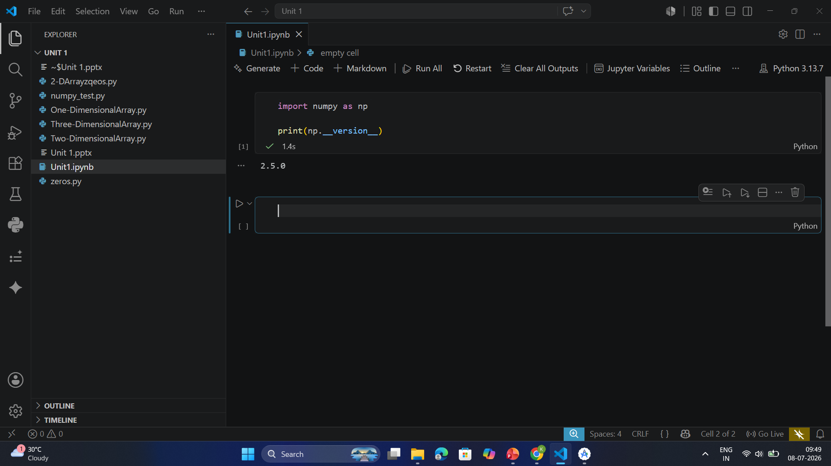
Checking NumPy Version

Slide 12
Importing NumPy
import numpy as np
Why use np?
Instead of writing
numpy.array()
we simply write
np.array()
This is the standard convention used worldwide.
https://colab.research.google.com/drive/1YjiurtIhdNsDW45S2P6HaiLEX74yeAFa#scrollTo=5EHW7GCUNiOr

Slide 13
Creating NumPy Arrays
Definition
A NumPy array is a collection of elements of the same data type, stored in contiguous memory locations.

Slide 14
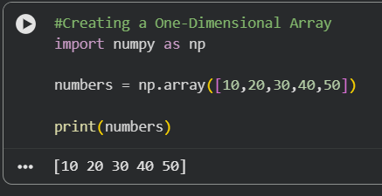
Creating a One-Dimensional Array

Slide 15
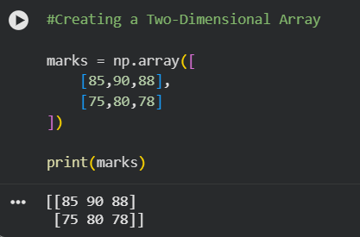
Creating a Two-Dimensional Array

Slide 16
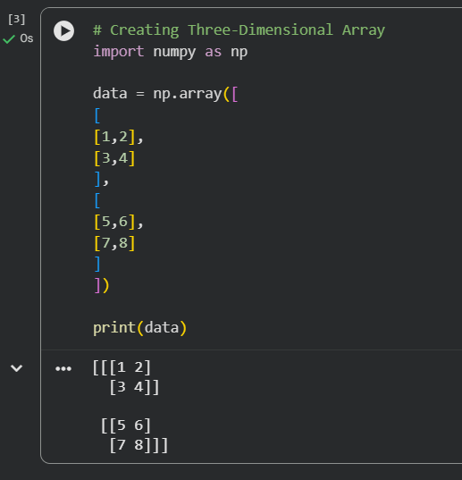
Creating Three-Dimensional Array

Slide 17
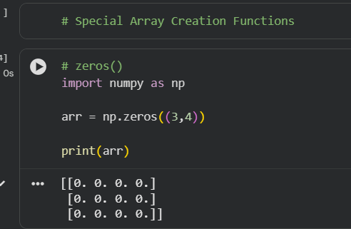
Special Array Creation Functions
1. zeros()
Definition
Creates an array filled with zeros.
Syntax
np.zeros(shape)

Slide 18
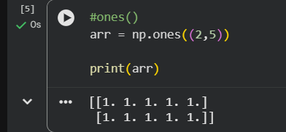
Special Array Creation Functions
2. ones()
Definition
Creates an array where every element is 1.

Slide 19
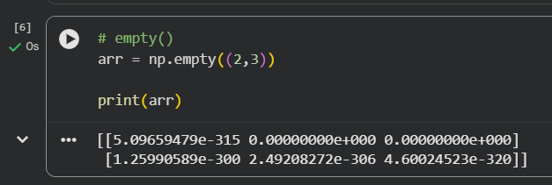
Special Array Creation Functions
3. empty()
Definition
Creates an array without initializing its values.

Slide 20
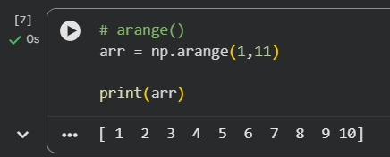
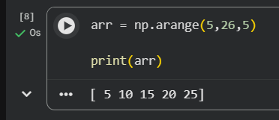
Special Array Creation Functions
4. arange()
Definition
Creates equally spaced values within a range.
Syntax
np.arange(start, stop, step)

Slide 21
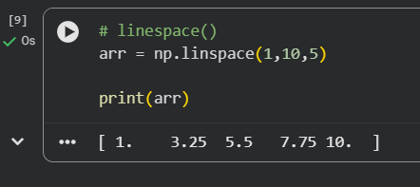
Special Array Creation Functions
5. linspace()
Definition
Creates equally spaced numbers between two values.

Slide 22
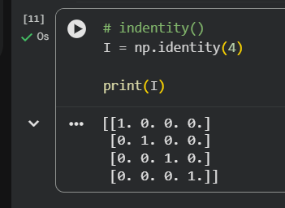
Special Array Creation Functions
6. identity()
Creates an identity matrix.

Slide 23
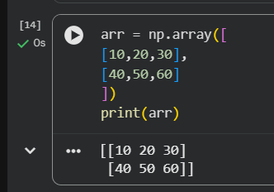
Array Attributes

Slide 24
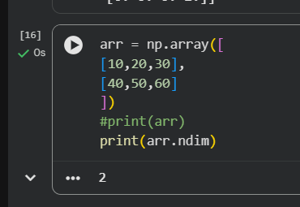
ndim
Number of dimensions.

Slide 25
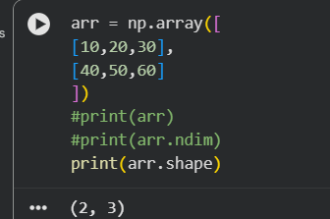
shape
Rows and columns.

Slide 26
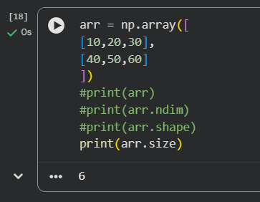
size
Total elements.

Slide 27
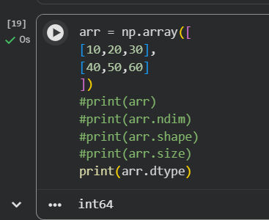
dtype
Data type.

Slide 28
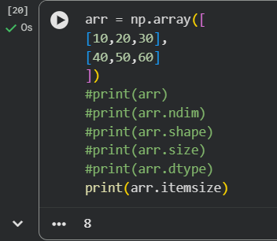
itemsize
Size occupied by one element.

Slide 29
Array Indexing
Definition
Indexing is the process of accessing individual elements of an array using their index positions.

Slide 30
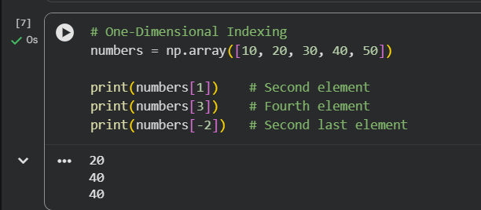
Array Indexing
One-Dimensional Indexing

Slide 31
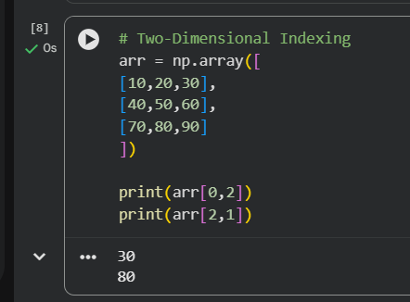
Array Indexing
Two-Dimensional Indexing

Slide 32
Array Slicing
Array slicing in NumPy is used to access a portion of an array without modifying the original data. It is similar to Python list slicing but works for multidimensional arrays as well.
Syntax
array[start:stop:step]
start: Index where slicing begins (default = 0)
stop: Index where slicing ends (not included)
step: Interval between elements (default = 1)

Slide 33
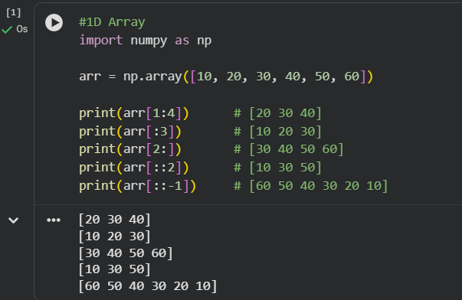
Array Slicing
Example 1: 1D Array

Slide 34
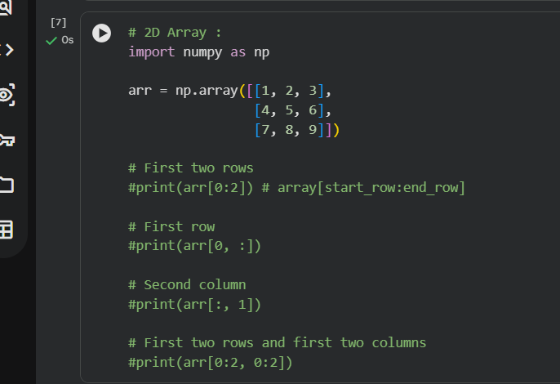
Array Slicing
Example 2: 2D Array

Slide 35
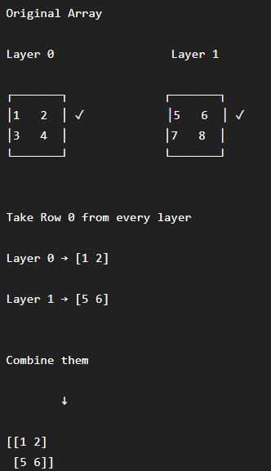
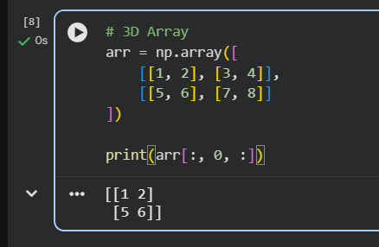
Array Slicing
Example 3: 3D Array

Slide 36
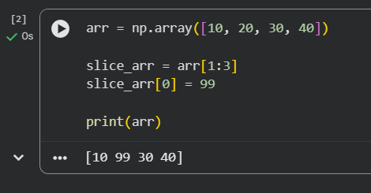
Array Slicing
Important Points
Slicing returns a view of the original array, not a copy.
Changes made to the sliced array may affect the original array.

Slide 37
Array Operations in NumPy
Array operations are the biggest advantage of NumPy over Python lists. Instead of using loops, NumPy performs operations on entire arrays at once, making the code shorter and much faster.
We'll learn this topic step by step.

Slide 38
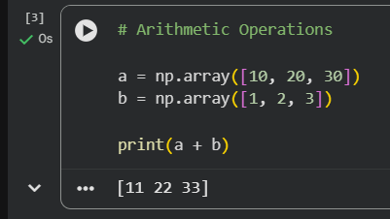
Array Operations in NumPy
1. Arithmetic Operations
Arithmetic operations are performed element-wise, meaning the operation is applied to each corresponding element.

Slide 39
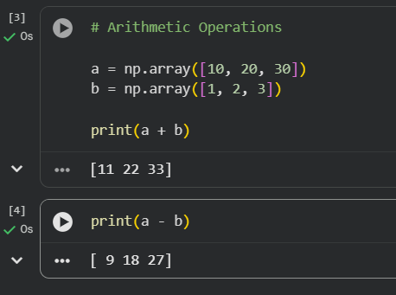
Array Operations in NumPy
Subtraction (-)

Slide 40
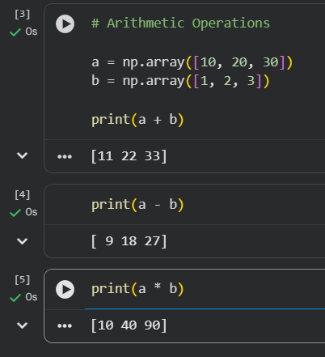
Array Operations in NumPy
Multiplication (*)

Slide 41
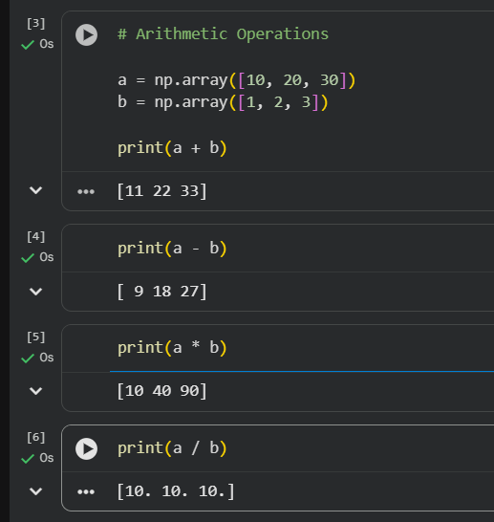
Array Operations in NumPy
Division (/)

Slide 42
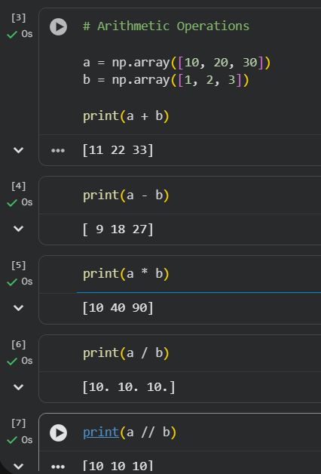
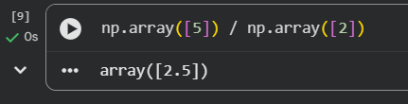
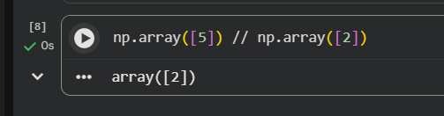
Array Operations in NumPy
Floor Division (//)
Floor division removes the decimal part.

Slide 43
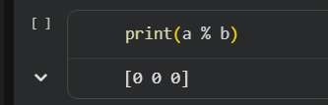
Array Operations in NumPy
Modulus (%)
Returns the remainder.

Slide 44
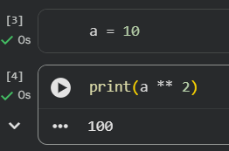
Array Operations in NumPy
Power (**) : Raises elements to a power.

Slide 45
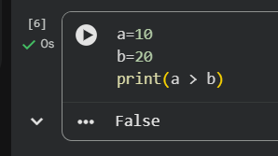
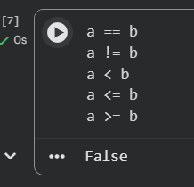
Array Operations in NumPy
Comparison Operations
These return True or False for each element.

Slide 46
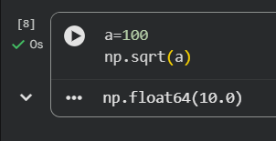
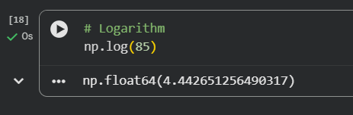
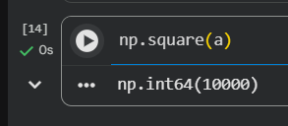
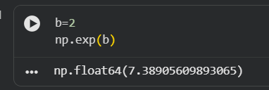
Array Operations in NumPy
Universal Mathematical Functions
NumPy provides many built-in mathematical functions.

Slide 47
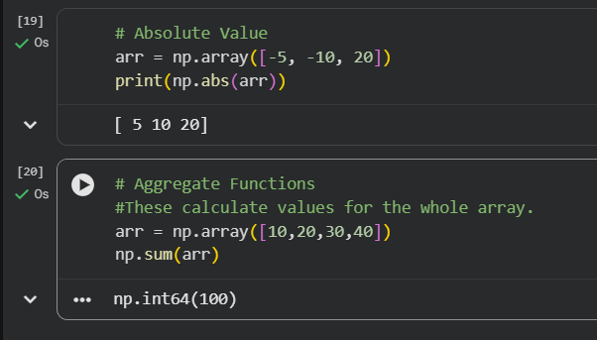
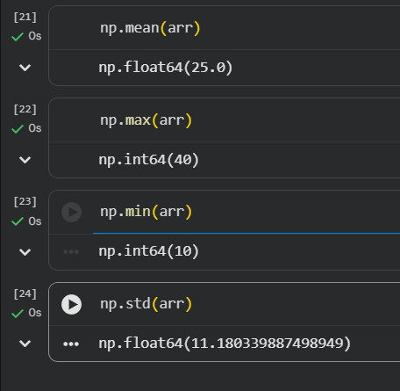
Array Operations in NumPy

Slide 48
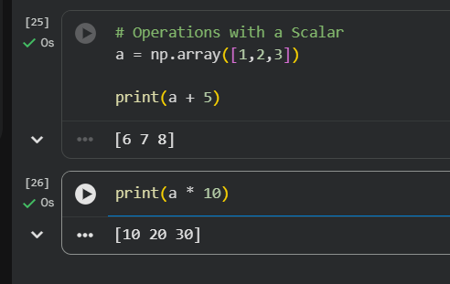
Operations with a Scalar
A scalar is a single number.

Slide 49
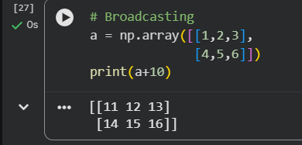
Broadcasting
NumPy automatically expands smaller arrays during operations when their shapes are compatible.

Slide 50
Mathematical and Statistical Functions in NumPy
This topic includes functions used to perform mathematical calculations and statistical analysis on NumPy arrays.

Slide 51
Mathematical and Statistical Functions in NumPy
1. Mathematical Functions
NumPy provides various mathematical functions to perform calculations on array elements.

Slide 52
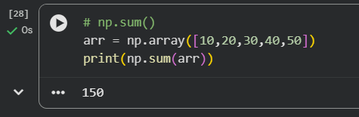
Mathematical and Statistical Functions in NumPy
a) np.sum()
Returns the sum of all elements in an array.

Slide 53
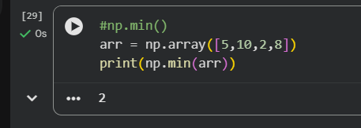
Mathematical and Statistical Functions in NumPy
b) np.min()
Returns the minimum value from an array.

Slide 54
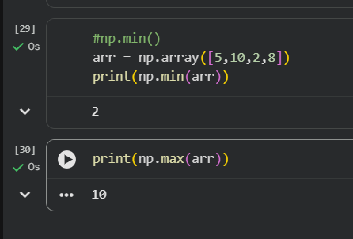
Mathematical and Statistical Functions in NumPy
c) np.max()
Returns the maximum value from an array.

Slide 55

Mathematical and Statistical Functions in NumPy
d) np.sqrt()
Calculates the square root of each element.

Slide 56

Mathematical and Statistical Functions in NumPy
e) np.exp()
Calculates exponential value (eˣ) of each element.

Slide 57

Mathematical and Statistical Functions in NumPy
f) np.log()
Calculates natural logarithm of each element.

Slide 58
Statistical Functions in NumPy
Statistical functions are used to analyze data and find important values like average, spread, and range.

Slide 59


Statistical Functions in NumPy
a) np.mean()
Calculates the arithmetic average of array elements.
Formula:
$Mean=\frac{Sum of values}{Number of values}$

Slide 60

Statistical Functions in NumPy
b) np.median()
Returns the middle value of sorted data.
If the number of elements is even, it returns the average of two middle values.

Slide 61

Statistical Functions in NumPy
c) np.std() (Standard Deviation)
Measures how much data values are spread around the mean.
A lower standard deviation means data values are closer to the mean.

Slide 62


Statistical Functions in NumPy
d) np.var() (Variance)
Measures the average squared difference from the mean.
Variance is the square of standard deviation.
Formula:
$Variance={\left(Standard Deviation\right)}^{2}$

Slide 63

Statistical Functions in NumPy
e) np.min()
Finds the smallest value in an array.

Slide 64

Statistical Functions in NumPy
f) np.max()
Finds the largest value in an array.

Slide 65

Statistical Functions in NumPy
g) np.sum()
Adds all array elements.

Slide 66

Statistical Functions in NumPy
h) np.percentile()
Finds the value below which a given percentage of data falls.

Slide 67

Statistical Functions in NumPy
i) np.cumsum() (Cumulative Sum)
Returns the running sum of elements.

Slide 68
Random Module in NumPy
The NumPy Random Module (np.random) is used to generate random numbers, random arrays, and random samples. It is widely used in data analysis, machine learning, simulations, and testing.
Import NumPy before using the random module:
import numpy as np

Slide 69
Random Module in NumPy
1. np.random.rand()
Generates random floating-point numbers between 0 and 1.
You can specify the shape of the array.
Syntax
np.random.rand(d0, d1, ..., dn)

Slide 70

Random Module in NumPy
Example 1: Single Random Number

Slide 71

Random Module in NumPy
Example 2: 2×3 Random Array

Slide 72
Random Module in NumPy
2. np.random.randint()
Generates random integers within a specified range.
The upper limit is not included.
Syntax
np.random.randint(low, high, size)

Slide 73

Random Module in NumPy
Example

Slide 74
Random Module in NumPy
3. np.random.choice()
Selects one or more random elements from an array or list.
Elements can be selected with or without repetition.
Syntax
np.random.choice(array, size)

Slide 75


Random Module in NumPy
Example

Slide 76

Random Module in NumPy
4. np.random.seed()
Sets the seed value.
Using the same seed always produces the same random numbers.
Useful for testing and reproducible results.
Syntax
np.random.seed(number)

Slide 77

Random Module in NumPy
5. np.random.shuffle()
Randomly rearranges (shuffles) the elements of an array.
It modifies the original array.
Syntax
np.random.shuffle(array)

Slide 78
Random Module in NumPy
6. np.random.normal()
Generates random numbers following a Normal (Gaussian) Distribution.
The normal distribution is also called the Bell Curve.
Syntax
np.random.normal(loc, scale, size)
Parameters
loc → Mean (default = 0)
scale → Standard deviation (default = 1)
size → Shape of output

Slide 79

Random Module in NumPy
6. np.random.normal()

Slide 80



Other Useful Random Functions

Slide 81
Matrix Operations in NumPy
A matrix is a two-dimensional array consisting of rows and columns. NumPy provides many functions to perform mathematical operations on matrices.

Slide 82

Matrix Operations in NumPy
Creating a Matrix:

Slide 83
Matrix Operations in NumPy
1. Matrix Addition
Matrix addition is performed by adding corresponding elements of two matrices.
Both matrices must have the same dimensions.
Syntax:
A + B

Slide 84


Matrix Operations in NumPy

Slide 85

Matrix Operations in NumPy
2. Matrix Subtraction
Subtracts corresponding elements of two matrices.
Syntax:
A - B

Slide 86

Matrix Operations in NumPy
3. Matrix Multiplication
Matrix multiplication is different from normal multiplication.
Rules:
Number of columns in the first matrix must equal the number of rows in the second matrix.
Example:
$A\left(m×n\right)×B\left(n×p\right)=C\left(m×p\right)$

Slide 87


Matrix Operations in NumPy
3. Matrix Multiplication
Method 1: Using np.matmul()

Slide 88

Matrix Operations in NumPy
3. Matrix Multiplication
Method 2: Using @ Operator

Slide 89


Matrix Operations in NumPy
4. Transpose of Matrix
Transpose converts rows into columns and columns into rows.
Function:
np.transpose()
or
matrix.T

Slide 90

Programming Using NumPy Arrays
This topic combines all the NumPy concepts you've learned.
Program 1: Find Sum, Average, Maximum and Minimum

Slide 91

Programming Using NumPy Arrays
Program 2: Find Even Numbers

Slide 92

Programming Using NumPy Arrays
Program 3: Square Every Element

Slide 93

Programming Using NumPy Arrays
Program 4: Reshape an Array
Explanation
reshape(3,4) converts a 1D array into a 3×4 matrix.
Total elements must remain the same.

Slide 94

Programming Using NumPy Arrays
Program 5: Matrix Addition

Slide 95


Programming Using NumPy Arrays
Program 6: Matrix Multiplication

Slide 96

Programming Using NumPy Arrays
Program 7: Transpose of Matrix

Slide 97

Programming Using NumPy Arrays
Program 8: Random Integer Array

Slide 98

Programming Using NumPy Arrays
Program 9: Sorting an Array

Slide 99

Programming Using NumPy Arrays
Program 10: Find Standard Deviation

